Slide 1
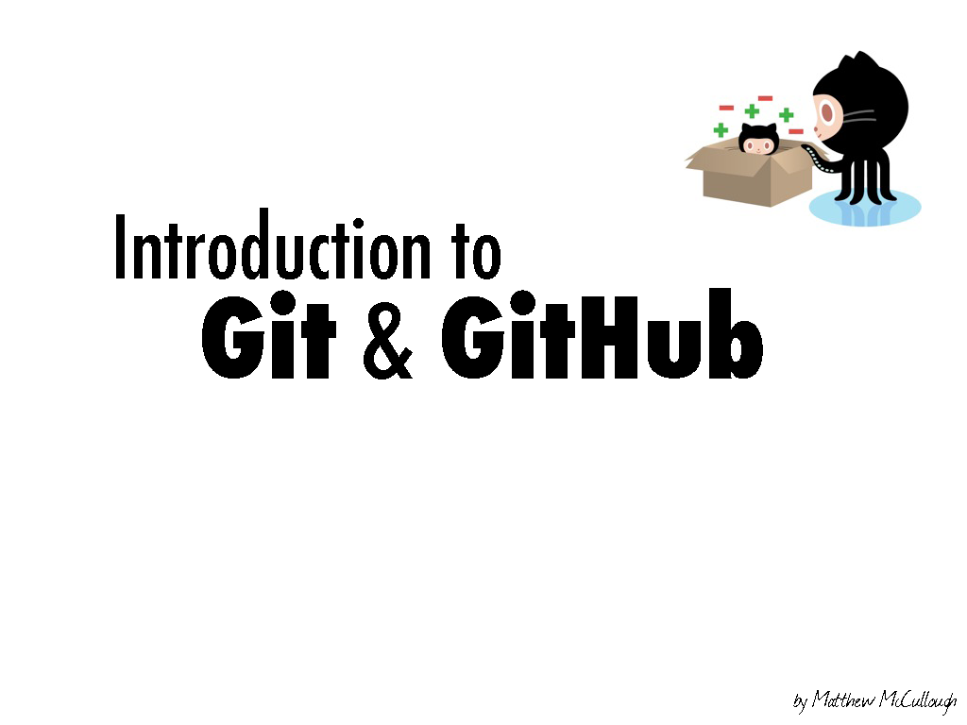
@pantaovay

Slide 2
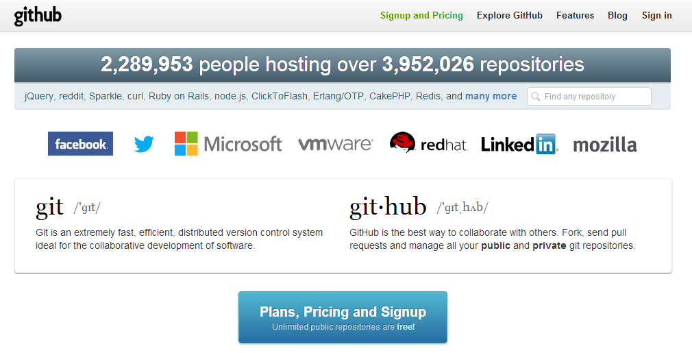

Slide 4
a brief introduction to
Git

Slide 5


Slide 6
In software development, Git is a distributed revision control and source code management system with an emphasis on speed.

Slide 7
In software development, Git is a distributed revision control and source code management system with an emphasis on speed.

Slide 8
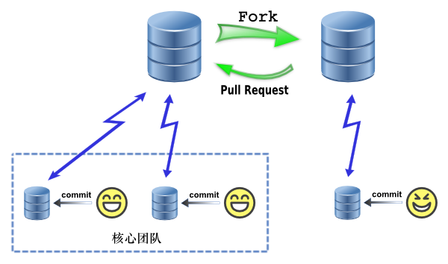
Core Team

Slide 9
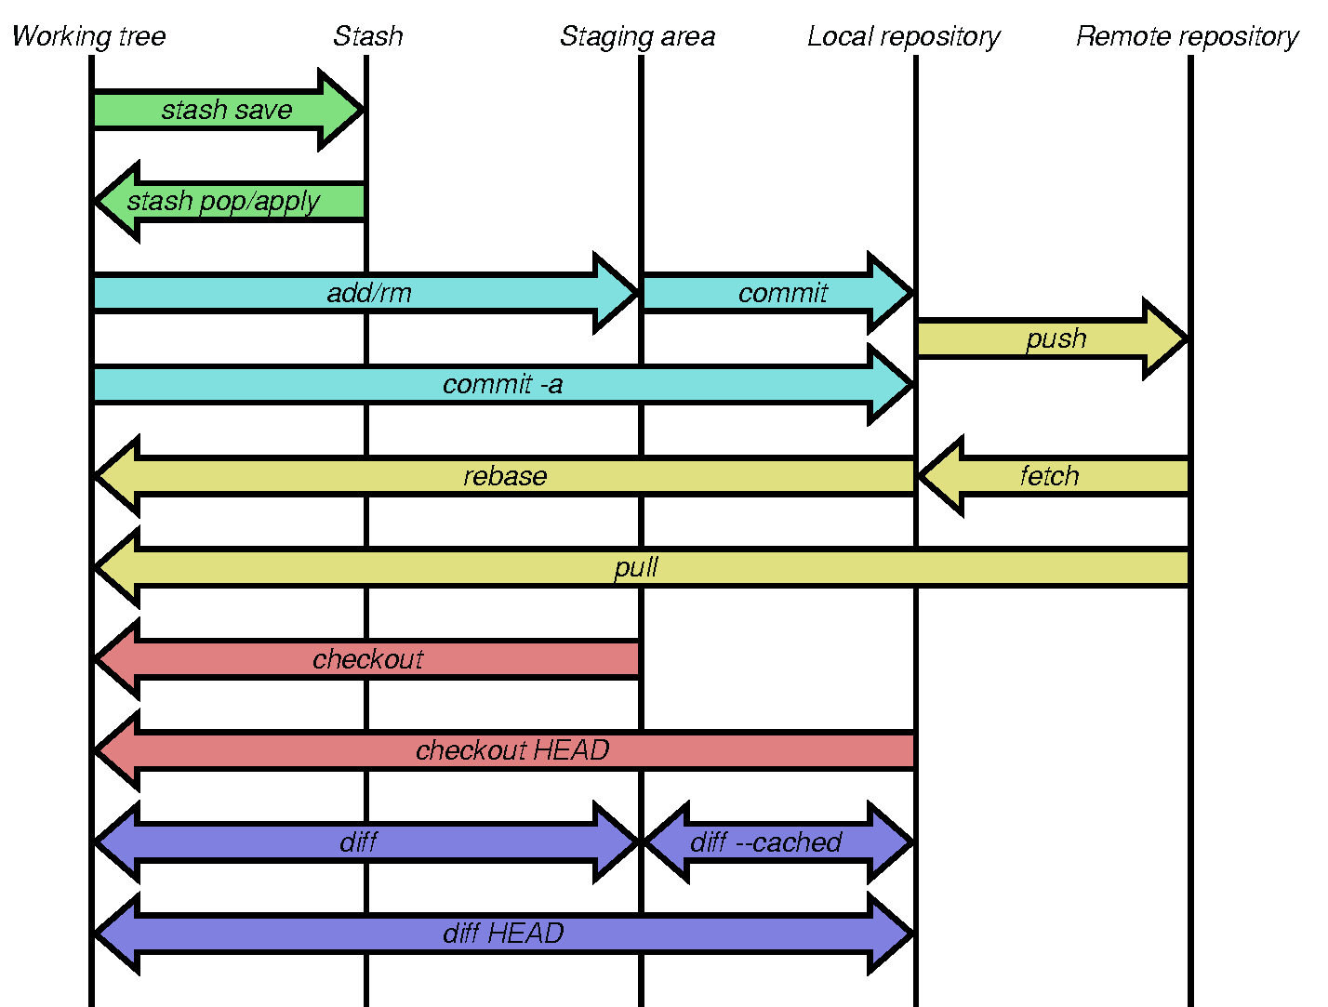

Slide 10


Slide 11
GitHub
a RIA for Git

Slide 12
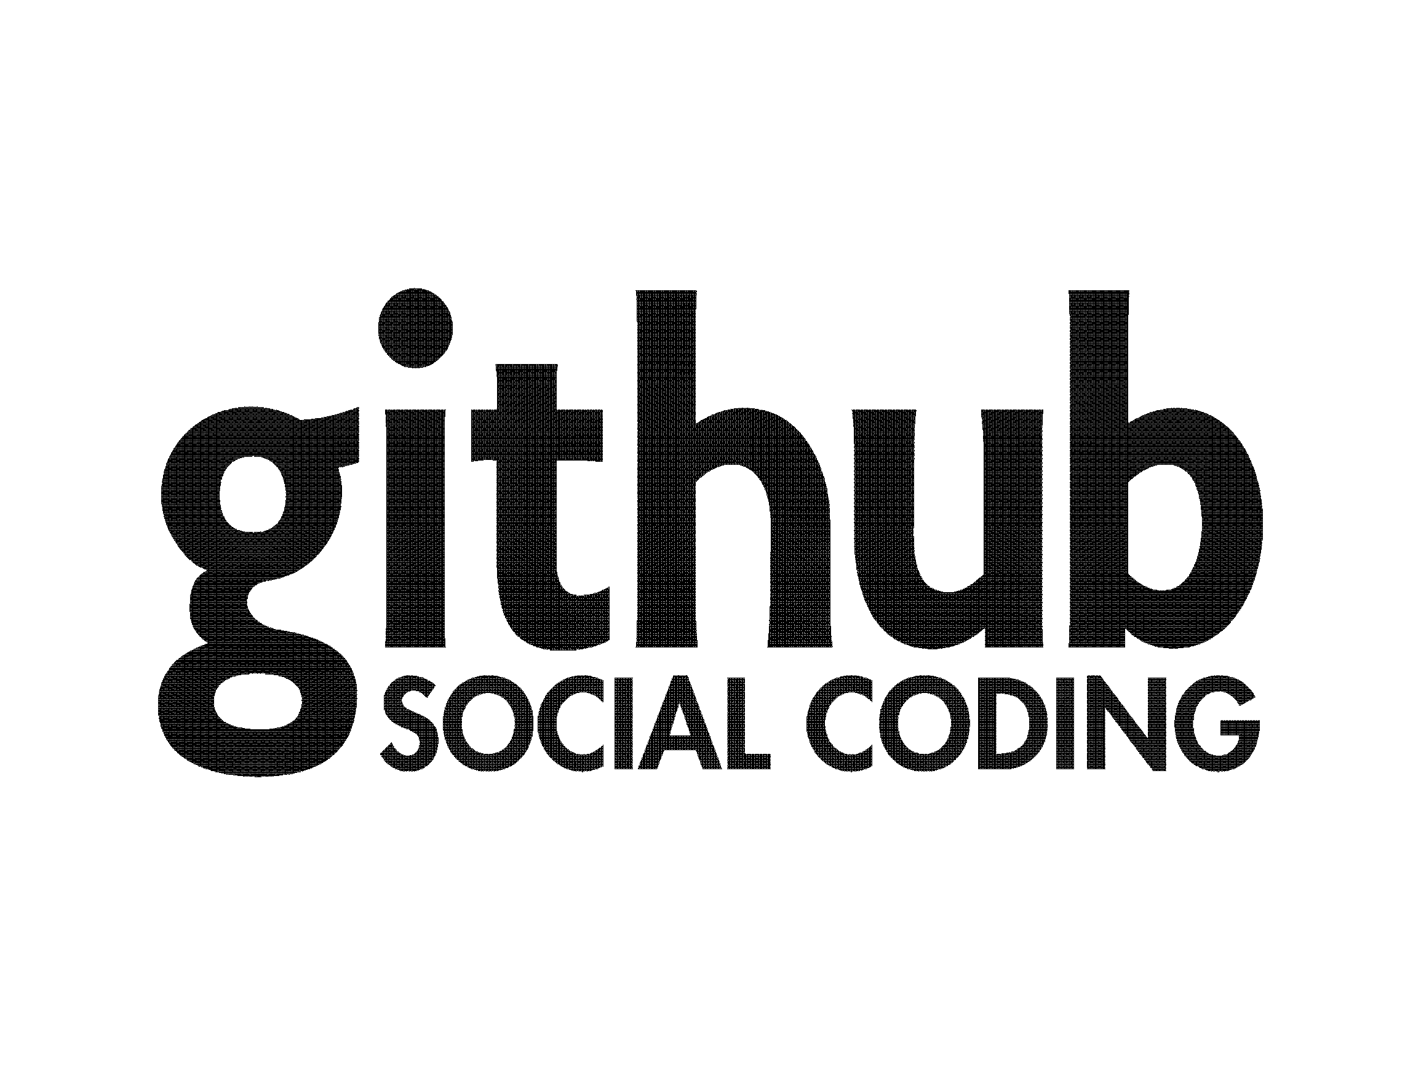

Slide 13


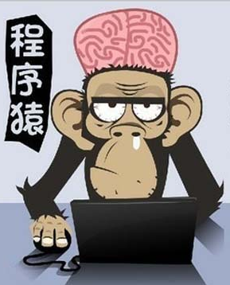
Facebook for Programmers
CODER

Slide 14
Based On Git
Beyond Git

Slide 15
Based On Git
Beyond Git
Ruby/HTML5
In-browser syntax highlighted code editing
Gist: Code snippets
GitHub Pages
Speaker Deck: Presentations
Graphs
Conversations on code changes

Slide 16
Based On Git
Beyond Git
Ruby/HTML5
In-browser syntax highlighted code editing
Gist: Code snippets
GitHub Pages
Speaker Deck: Presentations
Graphs
Conversations on code changes

Slide 17




T
oyhouse
Social Learning

Slide 18
Beyond GitHub
But Should Learn From GitHub Now

Slide 19
Workflow
Level and privilege

Slide 20
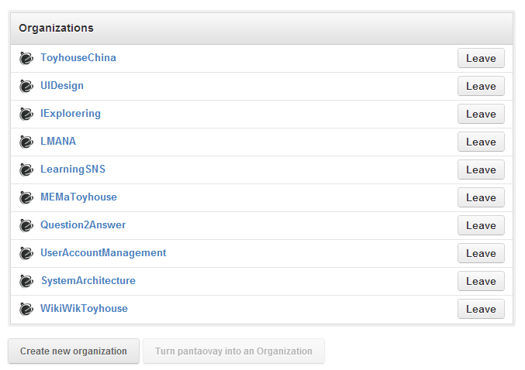

Slide 21
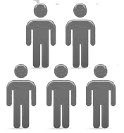



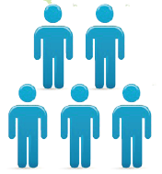
ToyhouseChina
MERGE
PULL REQUEST
FORK
FORK
FORK
FETCH&PULL
COMMIT
COMMIT
COMMIT

Slide 22
GitHub is productivity!
Just Learn by playing with it!

Slide 23
Thanks!

